Slide 1
The Kinect body tracking pipeline
Oliver Williams, Mihai Budiu
Microsoft Research, Silicon Valley
With slides contributed by Johnny Lee, Jamie Shotton
NASA Ames, February 14, 2011

Slide 2
Outline
Hardware overview
The body tracking pipeline
Learning a classifier from large data
Conclusions

Slide 3
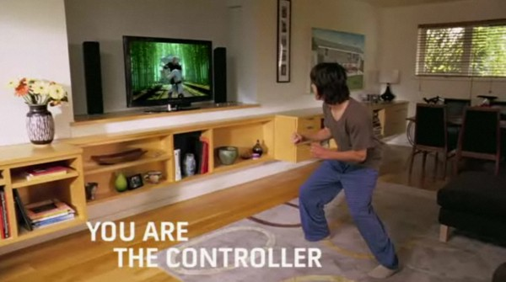
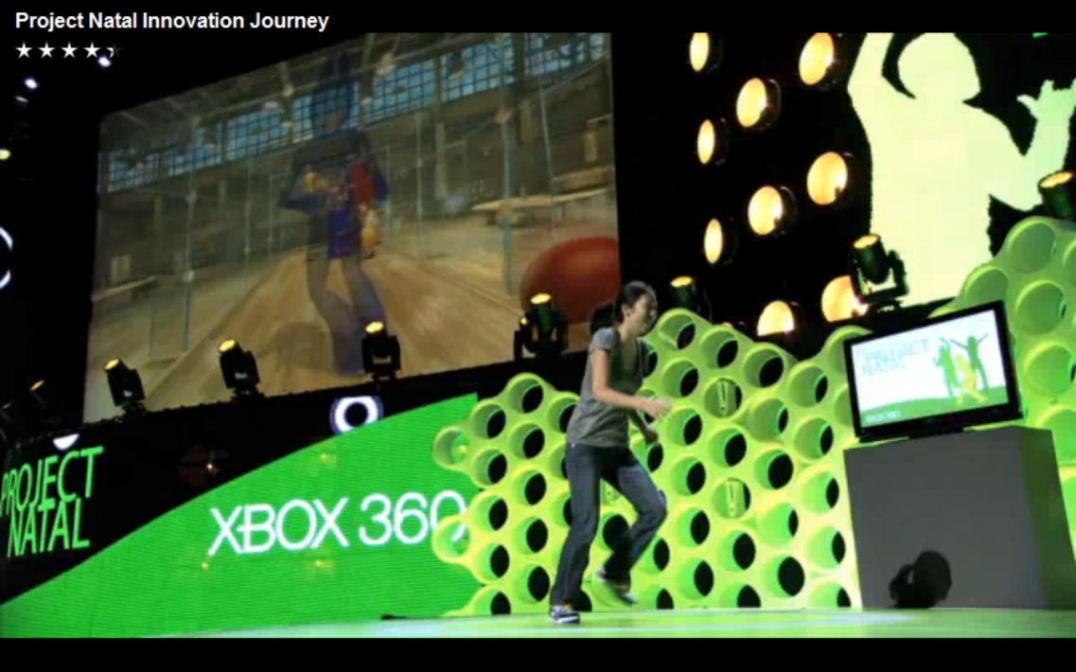
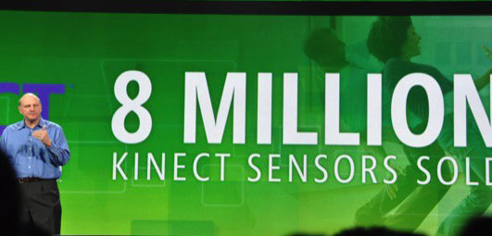
What is Kinect?

Slide 4






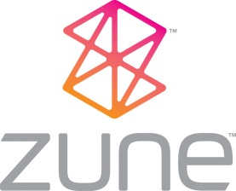
~2000 people
Caveat: we only have knowledge about a small part of this process.

Slide 5
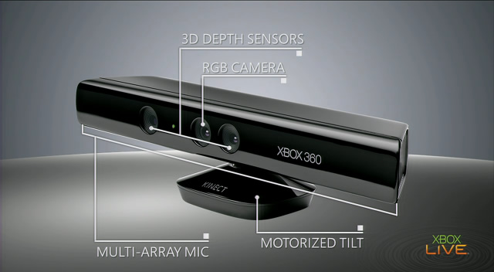
Input device

Slide 6
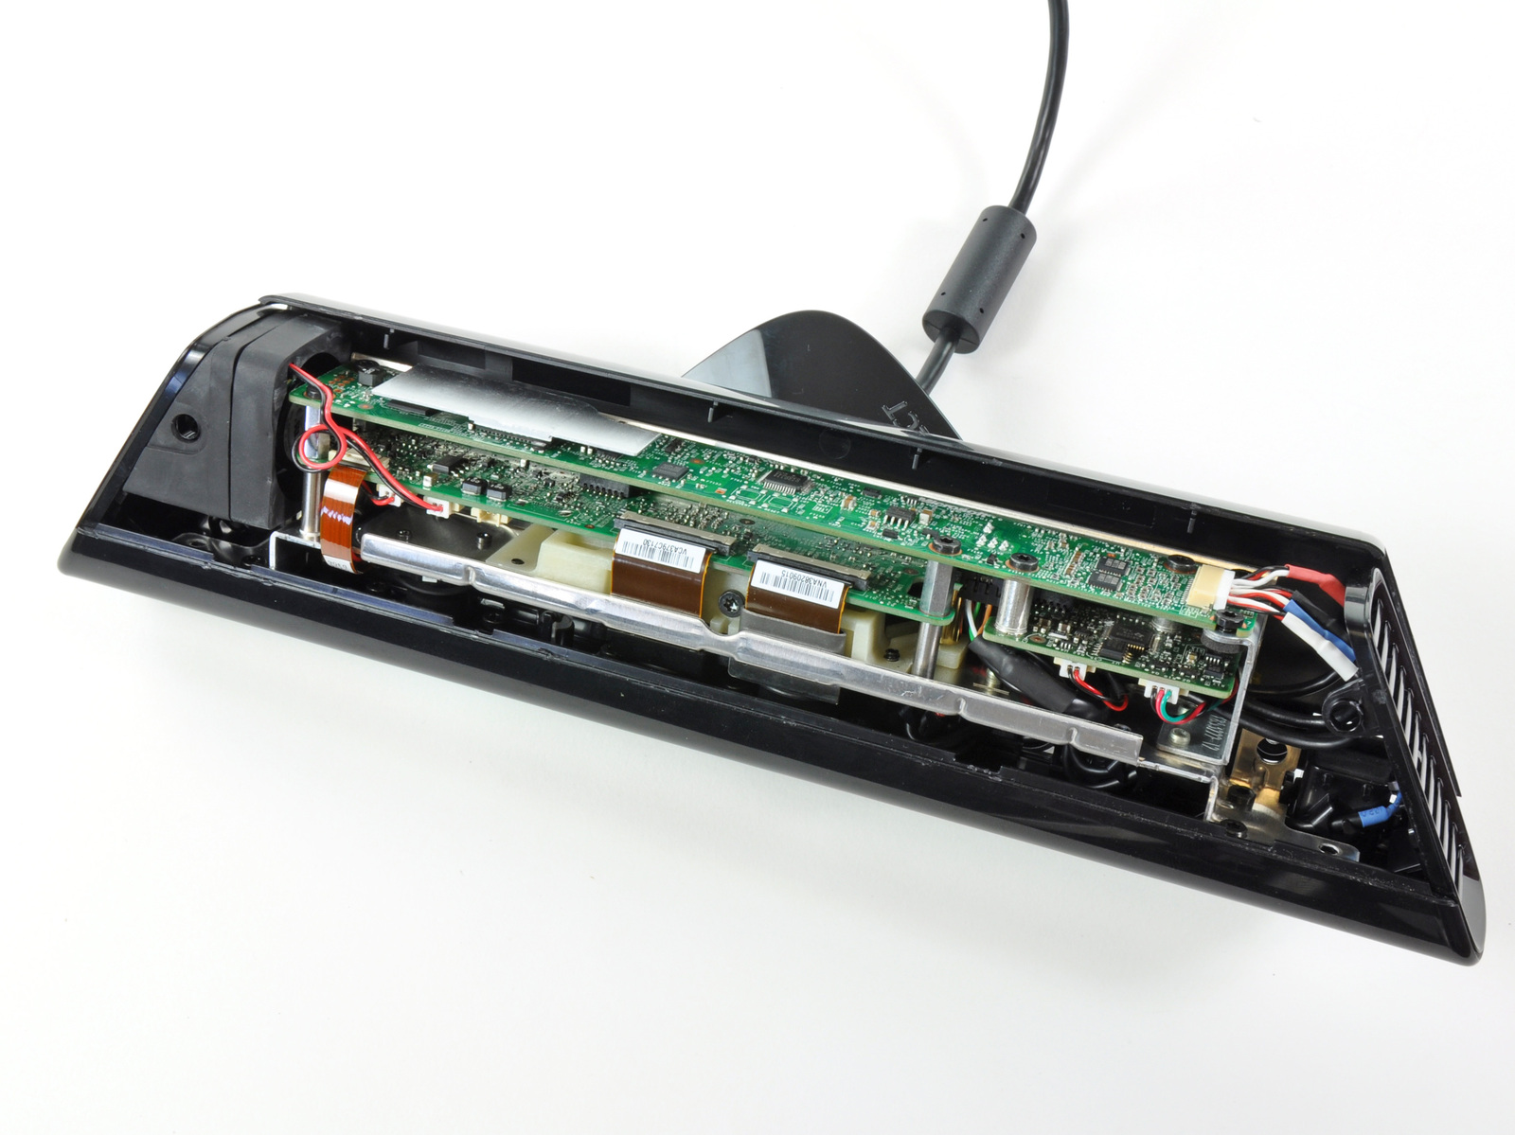
The Innards
Source: iFixit

Slide 7
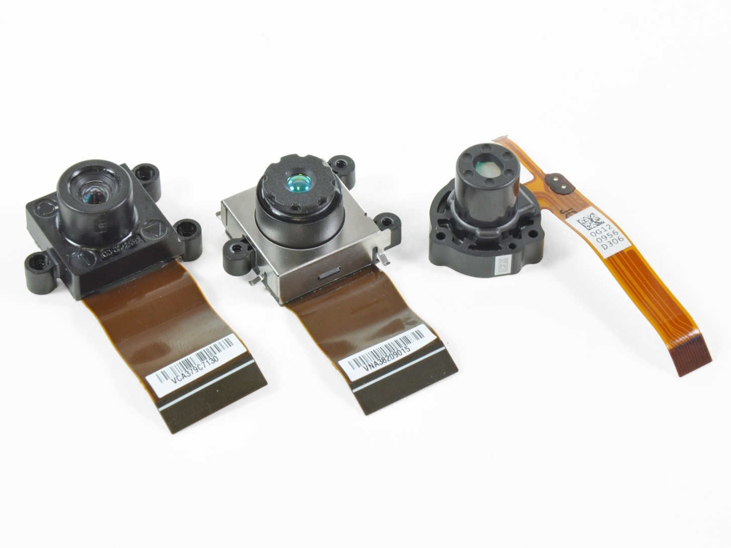
The vision system
RGB camera
IR camera
IR laser projector
Source: iFixit

Slide 8
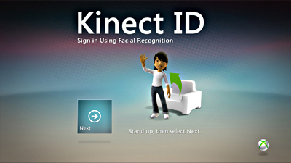
RGB Camera
Used for face recognition
Face recognition requires training
Needs good illumination

Slide 9
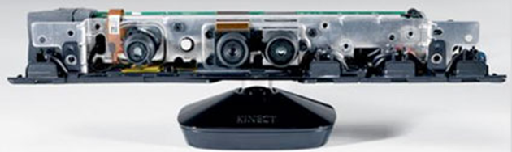
The audio sensors
4 channel multi-array microphone
Time-locked with console to remove game audio

Slide 10
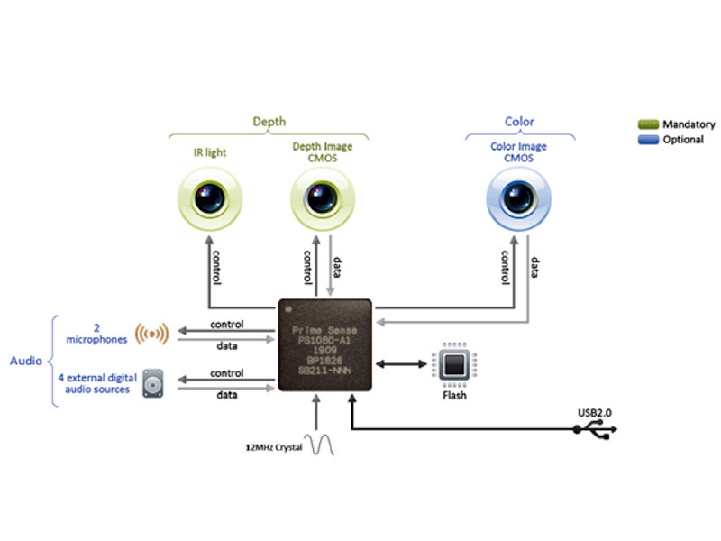
Prime Sense Chip
Xbox Hardware Engineering dramatically improved upon Prime Sense reference design performance
Micron scale tolerances on large components
Manufacturing process to yield ~1 device / 1.5 seconds

Slide 11
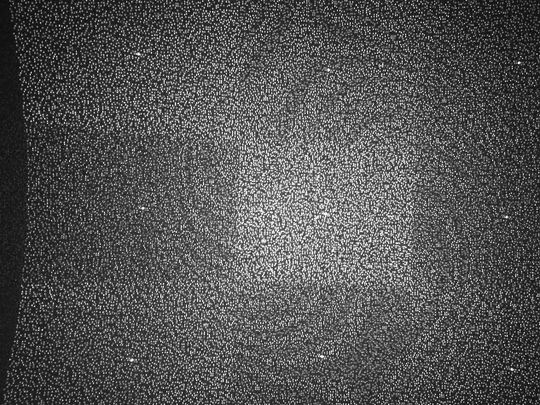
Projected IR pattern
Source: www.ros.org

Slide 12
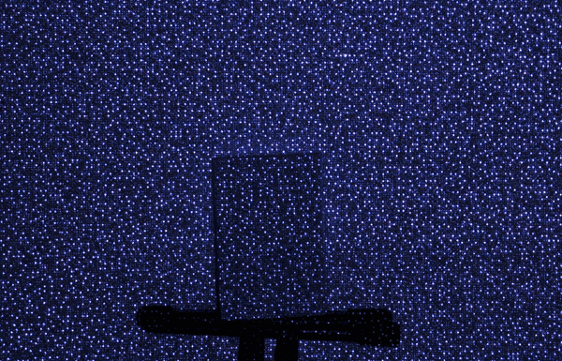
Depth computation
Source: http://nuit-blanche.blogspot.com/2010/11/unsing-kinect-for-compressive-sensing.html

Slide 13
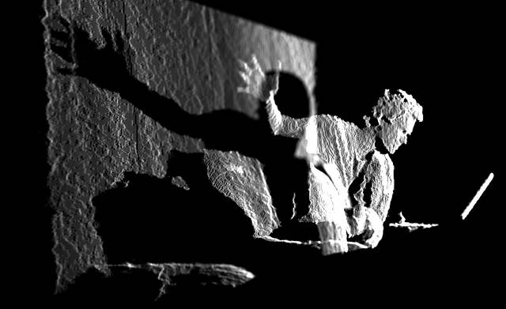
Depth map
Source: www.insidekinect.com

Slide 14
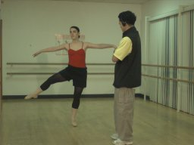
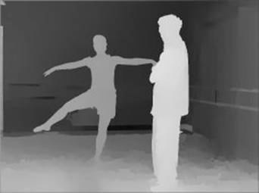
Kinect video output
30 HZ frame rate
57deg field-of-view
8-bit VGA RGB 640 x 480
11-bit monochrome 320 x 240

Slide 15
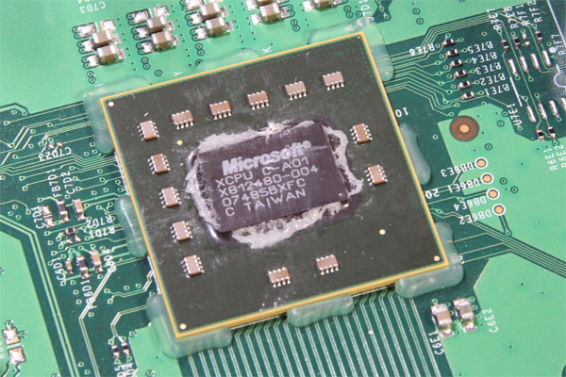
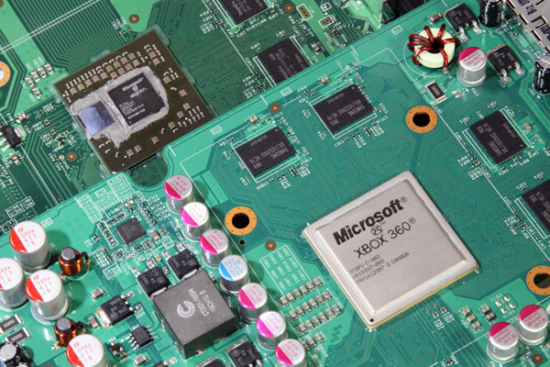
XBox 360 Hardware
Triple Core PowerPC 970, 3.2GHz
Hyperthreaded, 2 threads/core
500 MHz ATI graphics card
DirectX 9.5
512 MB RAM
2005 performance envelope
Must handle
real-time vision AND
a modern game
Source: http://www.pcper.com/article.php?aid=940&type=expert

Slide 16
The body tracking pipeline

Slide 17
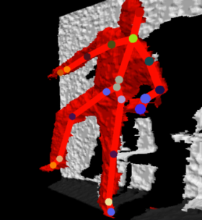
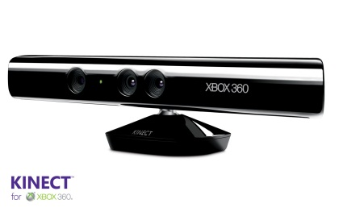
Generic Extensible Architecture
Expert 1
fuses the hypotheses
Arbiter
Expert 2
Expert 3
probabilistic
Raw
data
Skeleton
estimates
Final
estimate
Sensor
Stateless
Statefull

Slide 18

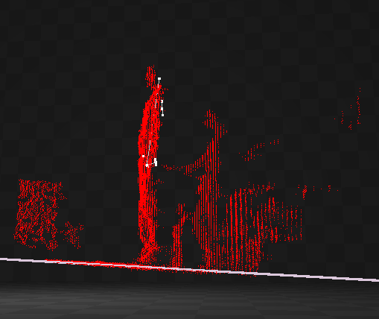
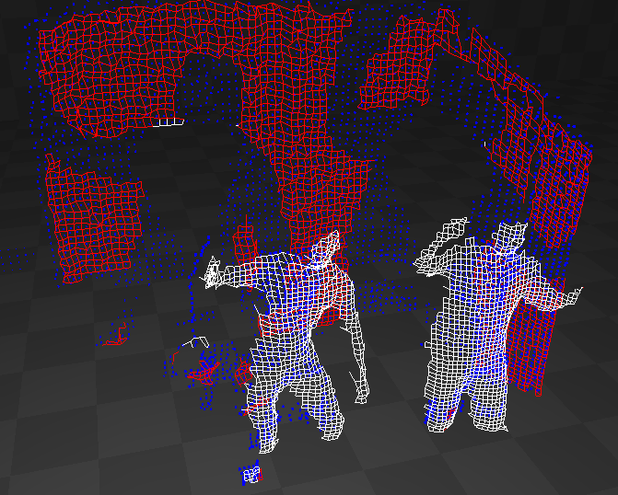
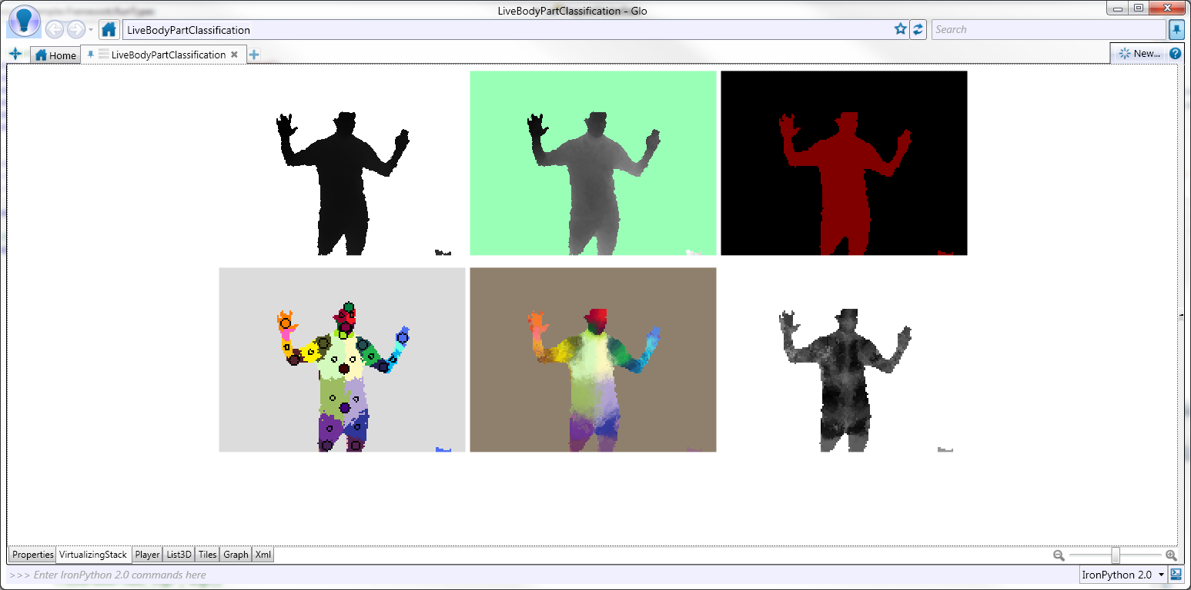
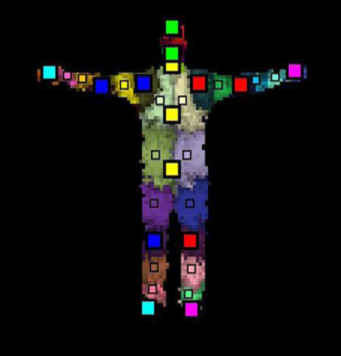

One Expert: Pipeline Stages
Sensor
Depth map
Background segmentation
Player separation
Body Part Classifier
Body Part Identification
Skeleton

Slide 19
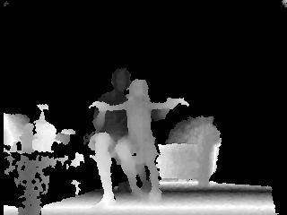
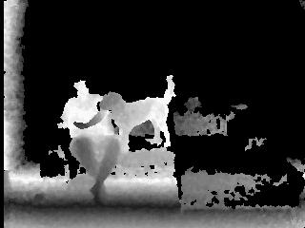
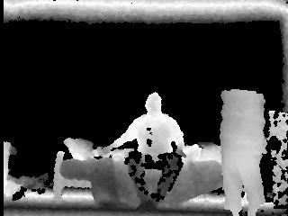
Sample test frames

Slide 20
Constraints
No calibration
no start/recovery pose
no background calibration
no body calibration
Minimal CPU usage
Illumination-independent

Slide 21
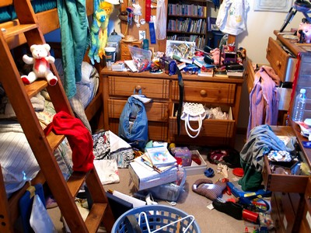
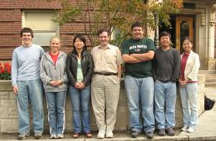

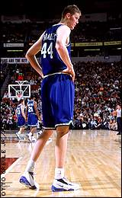
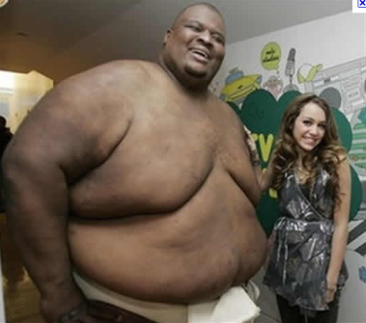
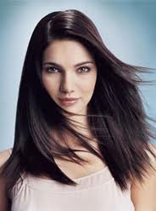
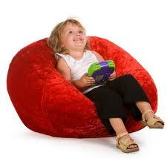
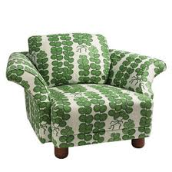


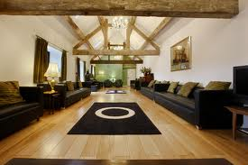
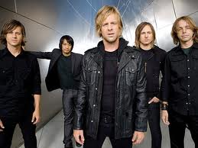
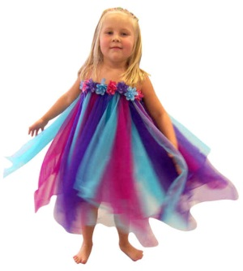
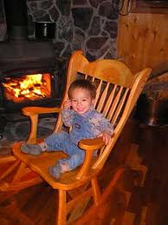
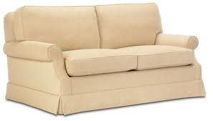
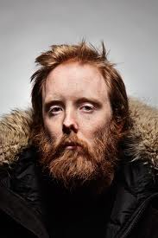

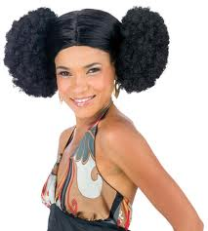
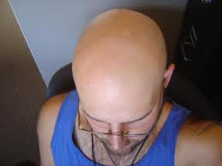

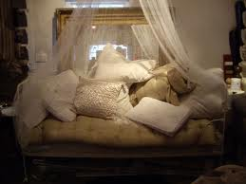
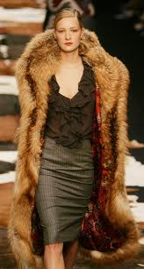
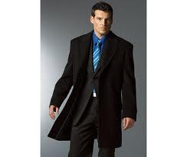
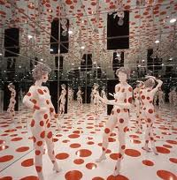
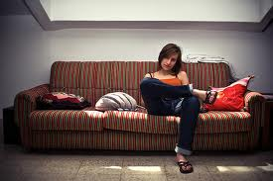
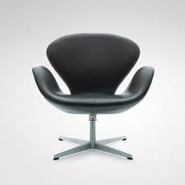

The test matrix
body size
hair
FOV
body type
clothes
angle
pets
furniture

Slide 22
Preprocessing
Identify ground plane
Separate background (couch)
Identify players via clustering

Slide 23
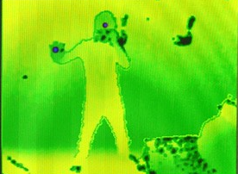
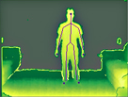
Two trackers
Hands + head tracking
Body tracking
not exposed through SDK

Slide 24
The body tracking problem
Classifier
Input
Depth map
Runs on GPU @ 320x240
Output
Body parts

Slide 25
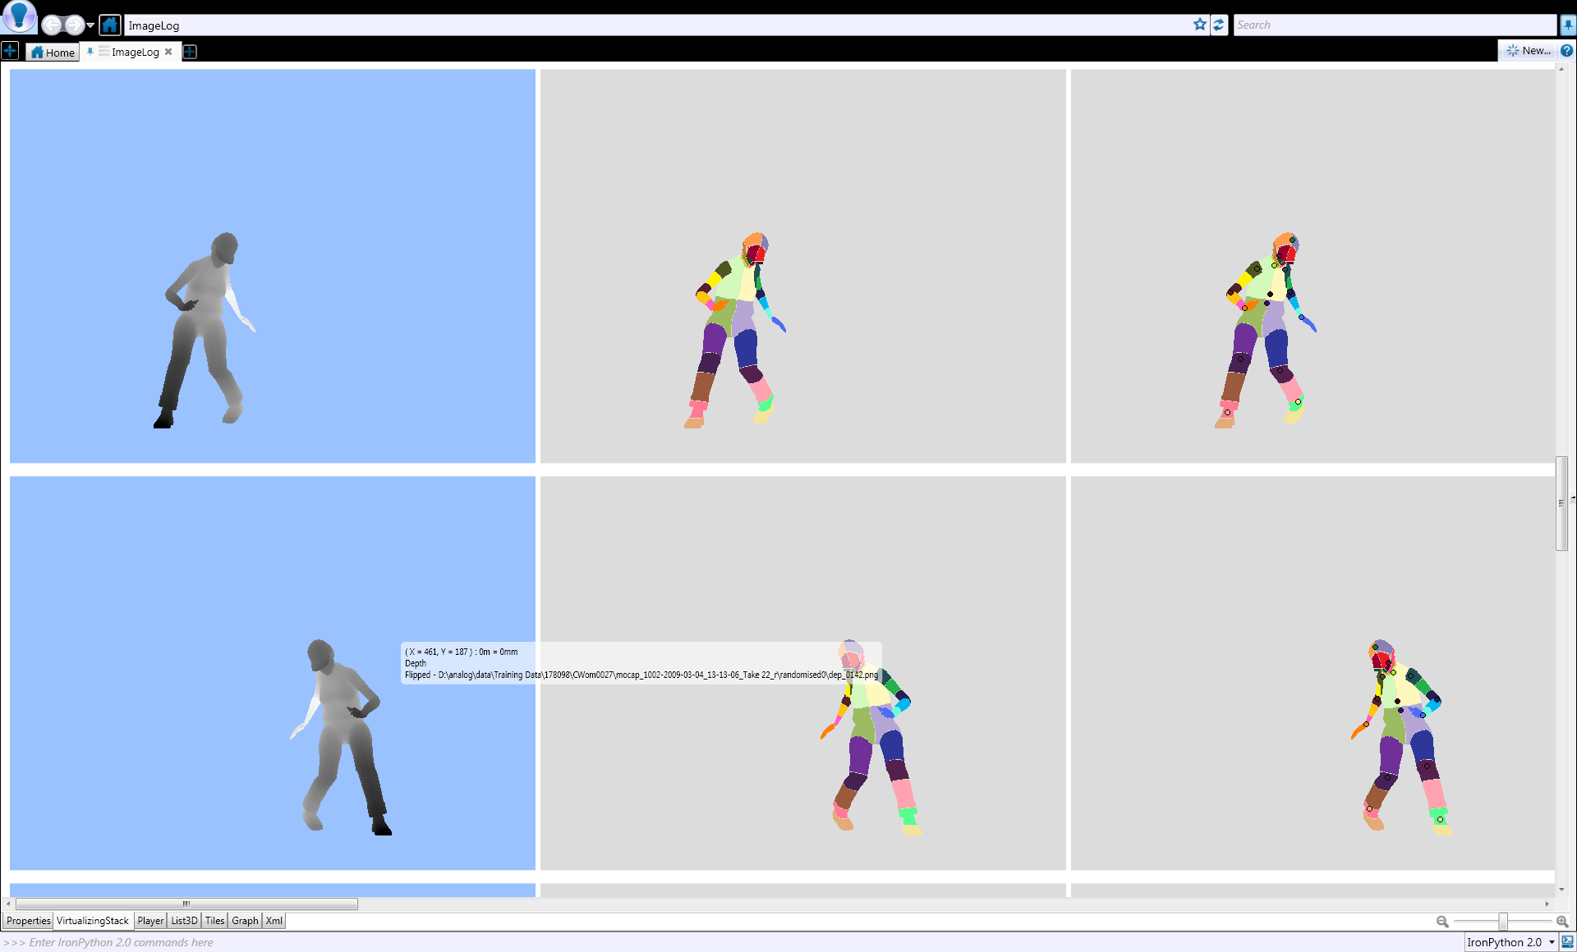


Training the classifier
Start from ground-truth data
depth paired with body parts
Train classifier to work across
pose
scene position
Height, body shape

Slide 26


Getting the Ground Truth (1)
Use synthetic data (3D avatar model)
Inject noise

Slide 27


Getting the Ground Truth (2)
Motion Capture:
Unrealistic environments
Unrealistic clothing
Low throughput

Slide 28

Getting the Ground Truth (3)
Manual Tagging:
Requires training many people
Potentially expensive
Tagging tool influences biases in data.
Quality control is an issue
1000 hrs @ 20 contractors ~= 20 years

Slide 29

Getting the Ground Truth (4)
Amazon Mechanical Turk:
Build web based tool
Tagging tool is 2D only
Quality control can be done with redundant HITS
2000 frames/hr @ $0.04/HIT -> 6 yrs @ $80/hr

Slide 30

Classifying pixels
Compute P(c_{i}|w_{i})
pixels i = (x, y)
body part c_{i}
image window w_{i}
Learn classifier P(c_{i}|w_{i}) from training data
randomized decision forests
example image windows
window moves with classifier

Slide 31




Features
$f_{θ}\left(I, x\right)=d_{I}\left(x+\frac{u}{d_{I}\left(x\right)}\right)$-$d_{I}\left(x+\frac{v}{d_{I}\left(x\right)}\right)$
$$d_{I}\left(x\right)$$
-- depth of pixel x in image I
$θ$ = (u,v)
-- parameter describing offets u and v

Slide 32
From body parts to joint positions
Compute 3D centroids for all parts
Generates (position, confidence)/part
Multiple proposals for each body part
Done on GPU

Slide 33

From joints positions to skeleton
Tree model of skeleton topology
Has cost terms for:
Distances between connected parts (relative to “body size”)
Bone proximity to body parts
Motion terms for smoothness

Slide 34

Where is the skeleton?

Slide 35

Learning The Body Parts Classifier from a Mountain of Data

Slide 36

Learn from Data
Training examples
Machine learning
Classifier

Slide 37

Cluster-based training
Classifier
Training examples
Machine learning
DryadLINQ
> Millions of input frames
> 10²⁰ objects manipulated
Sparse, multi-dimensional data
Complex datatypes (images, video, matrices, etc.)
Dryad

Slide 38
Data-Parallel Computation
Application
SQL
Sawzall, Java
≈SQL
LINQ, SQL
Parallel Databases
Sawzall,FlumeJava
Pig, Hive
DryadLINQ Scope
Language
Map-Reduce
Hadoop
Dryad
Execution
GFS BigTable
HDFS
S3
Cosmos
Azure SQL Server
Storage

Slide 39

Dryad = 2-D Piping
Unix Pipes: 1-D
grep | sed | sort | awk | perl
Dryad: 2-D
grep¹⁰⁰⁰ | sed⁵⁰⁰ | sort¹⁰⁰⁰ | awk⁵⁰⁰ | perl⁵⁰
Notes:
Dryad is a generalization of the Unix piping mechanism: instead of uni-dimensional (chain) pipelines, it provides two-dimensional pipelines. The unit is still a process connected by a point-to-point channel, but the processes are replicated.

Slide 40
Virtualized 2-D Pipelines
Notes:
This is a possible schedule of a Dryad job using 2 machines.

Slide 41


Virtualized 2-D Pipelines

Slide 42

Virtualized 2-D Pipelines

Slide 43
Virtualized 2-D Pipelines

Slide 44
Virtualized 2-D Pipelines
2D DAG
multi-machine
virtualized
Notes:
The Unix pipeline is generalized 3-ways:
2D instead of 1D
spans multiple machines
resources are virtualized: you can run the same large job on many or few machines

Slide 45



Fault Tolerance
Notes:
Vertex failures and channel failures are handled differently.

Slide 46


LINQ
=> DryadLINQ
Dryad
Notes:
DryadLINQ adds a wealth of features on top of plain Dryad.

Slide 47
LINQ = .Net+ Queries
Collection<T> collection;
bool IsLegal(Key);
string Hash(Key);
var results = from c in collection where IsLegal(c.key) select new { Hash(c.key), c.value};
Notes:
Language Integrated Query is an extension of .Net which allows one to write declarative computations on collections (green part).

Slide 48

DryadLINQ Data Model
.Net objects
Partition
Collection

Slide 49

DryadLINQ = LINQ + Dryad
Collection<T> collection;
bool IsLegal(Key k);
string Hash(Key);
var results = from c in collection where IsLegal(c.key) select new { Hash(c.key), c.value};
Vertex code
Query plan
(Dryad job)
Data
collection
C#
C#
C#
C#
results
Notes:
DryadLINQ translates LINQ programs into Dryad computations:
- C# and LINQ data objects become distributed partitioned files.
- LINQ queries become distributed Dryad jobs.
- C# methods become code running on the vertices of a Dryad job.

Slide 50
Language Summary
Where
Select
GroupBy
OrderBy
Aggregate
Join

Slide 51

Highly efficient parallellization
machine
time

Slide 52
Conclusions

Slide 53

Huge Commercial Success

Slide 54

Tremendous Interest from Developers

Slide 55


Consumer Technologies Push The Envelope
Price: 6000$
Price: 150$

Slide 56

Unique Opportunity for Technology Transfer

Slide 57

I can finally explain to my son what I do for a living…

